Slide 1
Modulation of Movement by the Cerebellum
By: Nicole Phillips

Slide 2
Learning objectives
Explain the organization of afferent and efferent connections of the cerebellum
Describe the cytoarchitecture of cerebellar cortex
Describe the functional divisions of the cerebellum
Identify symptoms of cerebellar damage & how these elucidate the function of a healthy cerebellum

Slide 3
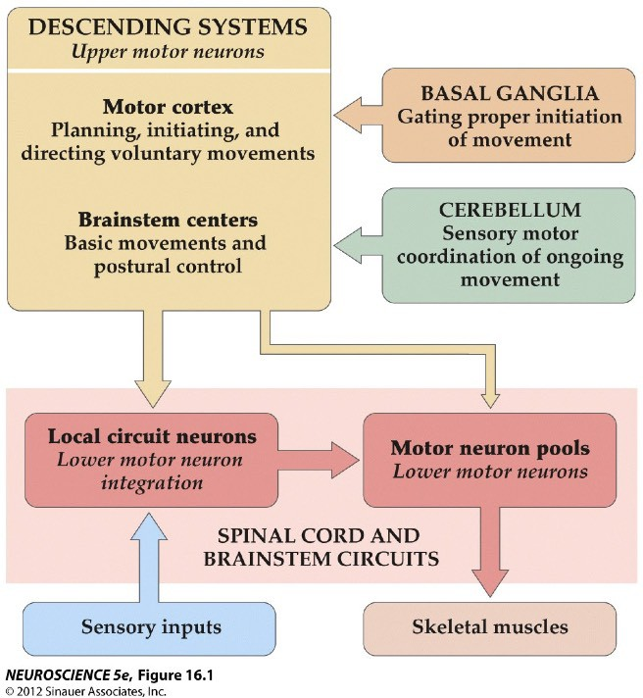
Four Neural Centers for Movement
3
Upper Motor Neurons (UMNs)
Top-down control of movement
2
Modulation of motor plans
4
1
Lower motor neurons (LMNs)
“Final common path” for initiating movement

Slide 4
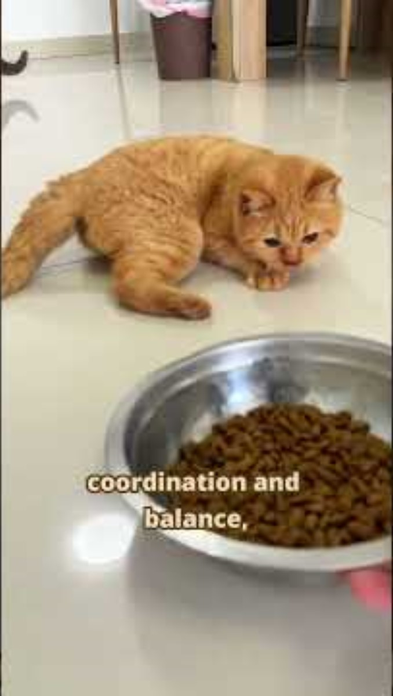
Cerebellar Hypoplasia
Notes:
https://www.youtube.com/shorts/EjTaVh_vn84

Slide 5
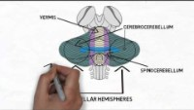

Slide 6
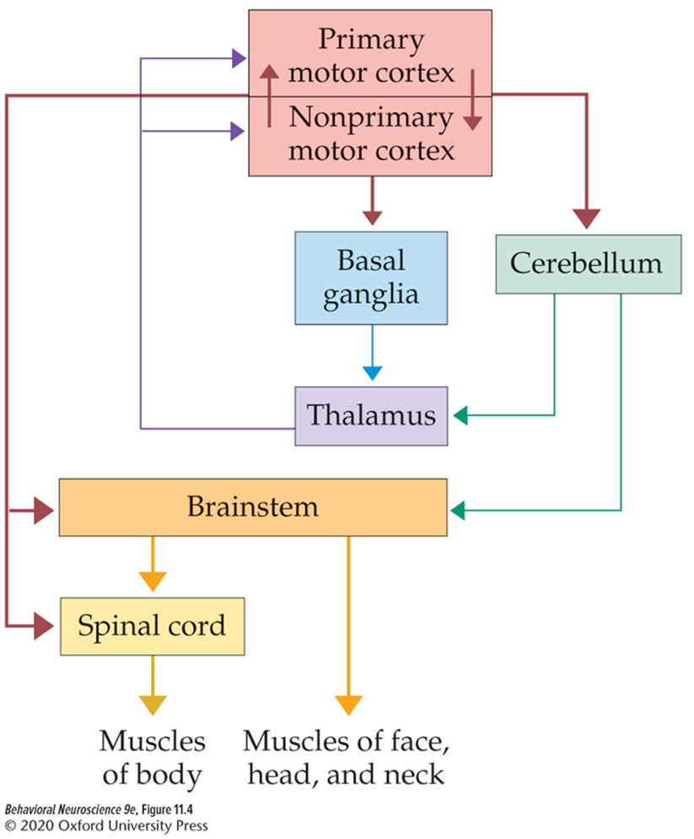
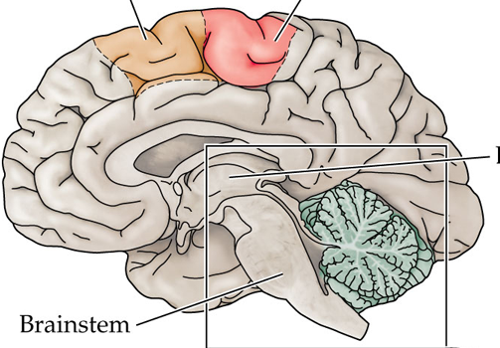
The Cerebellum
Modulates motor plans from motor cortex.
Plays an important role in:
  coordinating voluntary movements
  resolving “motor error”
  maintaining balance and posture
  regulating muscle tone
  procedural learning

Slide 7
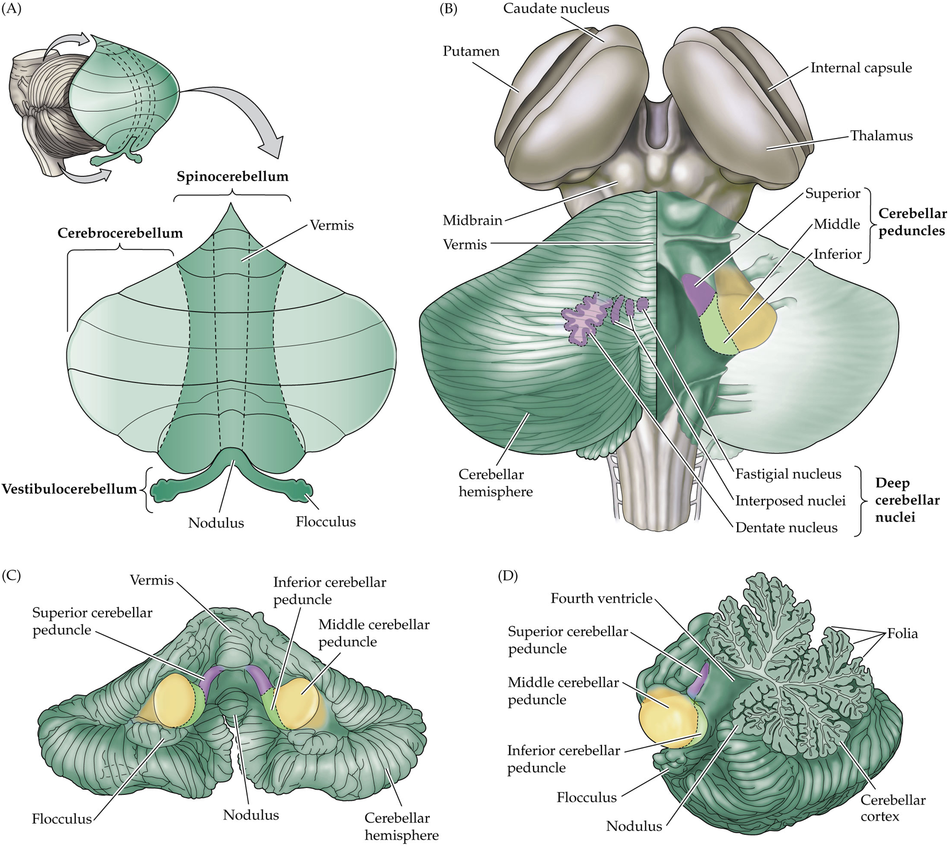
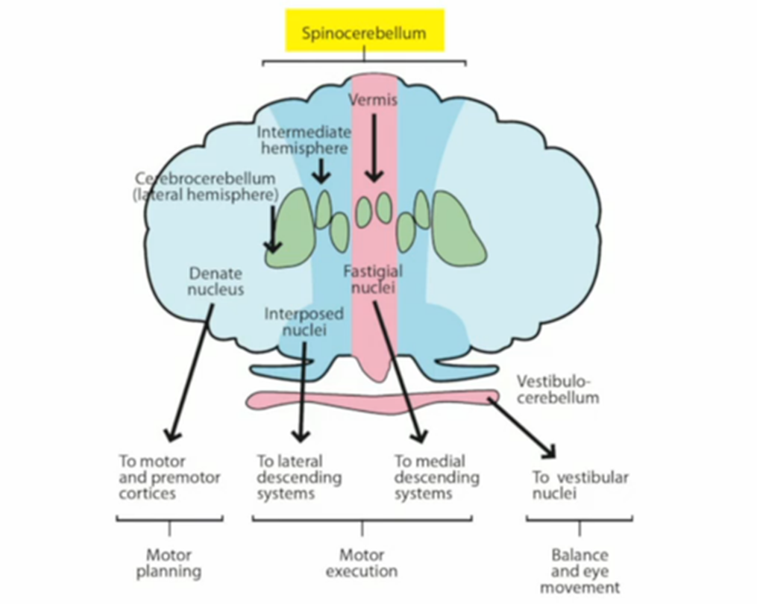
Parts of the Cerebellum
Cerebellar cortex
  Cerebrocerebellum
  Spinocerebellum
    Vermis
  Vestibulocerebellum
Cerebellar peduncles
  Superior
  Middle
  Inferior
Deep cerebellar nuclei
  Dentate nucleus
  Interposed nuclei
  Fastigial nuclei

Slide 8
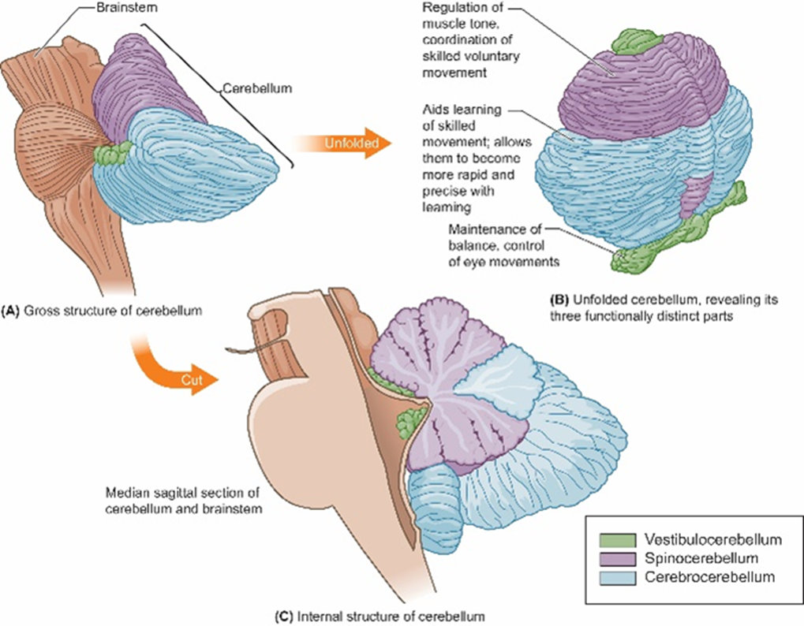
Functional Subdivisions of the
Cerebellar Cortex
Cerebrocerebellum
  Input from the “cerebrum”
  Procedural learning and highly skilled movements
Spinocerebellum
  Input from the spinal cord
  Regulation of muscle tone and coordination of voluntary movements
    Vermis important for movement of proximal muscles and certain eye movements
Vestibulocerebellum
  Input from the vestibular nuclei
  Maintaining balance and posture

Slide 9
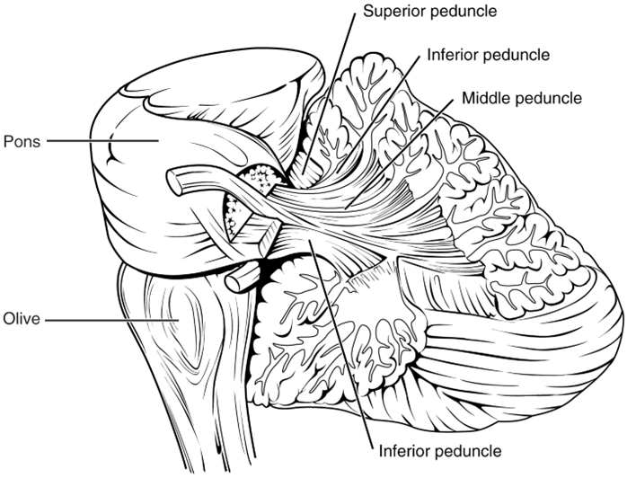
The Peduncles
Axon tracts connecting the cerebellum to other brain regions
Some have afferent (incoming) fibers, while others have efferent (outgoing) fibers.
Superior
  Major efferent pathway
  Tracts from the deep nuclei of cerebellum to
  contralateral cortex
Middle
  Major afferent pathway
  Tracts from the contralateral cortex
Inferior
  Afferent & efferent pathways
  Afferent tracts with ipsilateral proprioceptive information from the spinal cord, vestibular nuclei, and inferior olive
  Efferent tracts from deep cerebellar nuclei to the reticular formation
https://en.wikipedia.org/wiki/File:1612_Cerebellar_Peduncles-02.jpg

Slide 10
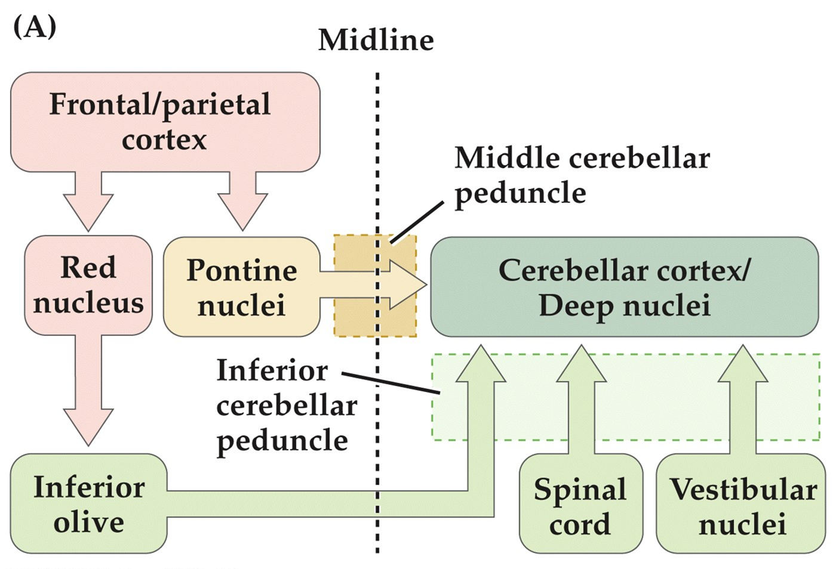

Major inputs to the Cerebellum
Cortex → Pontine nuclei → cerebrocerebellum
  Middle peduncle
Cortex → red nucleus → inferior olive → cerebrocerebellum
  Inferior peduncle
  Special role in procedural learning
Spinal cord → spinocerebellum
  Inferior peduncle
Vestibular nuclei → vestibulocerebellum
  Inferior peduncle

Slide 11
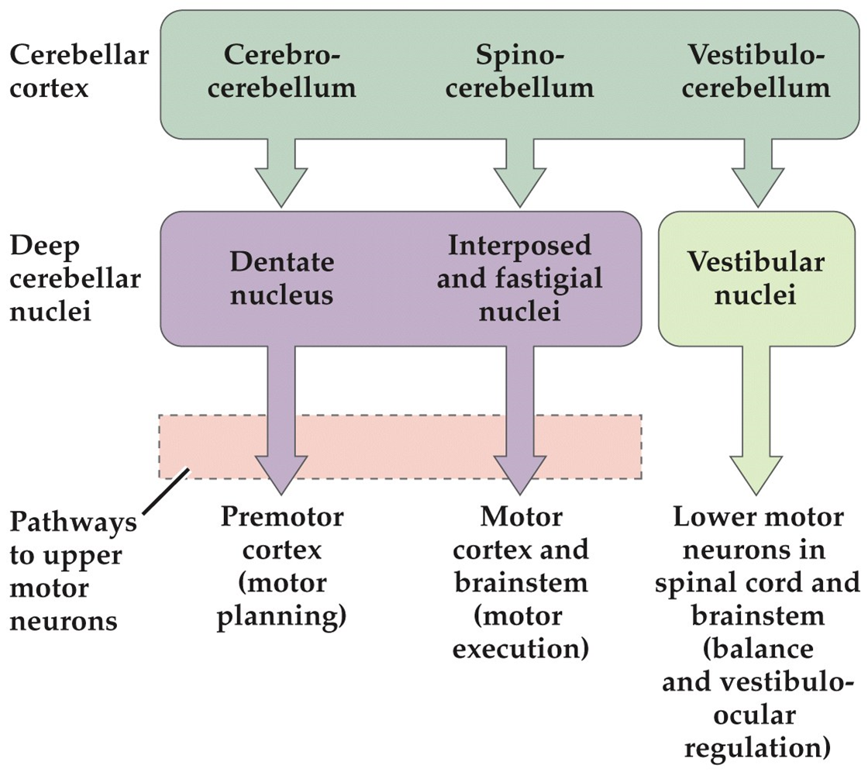
Major Outputs of the Cerebellum
Most efferent fibers from cerebellar cortex project to a specific region of the deep cerebellar nuclei.
  Vestibulocerebellum is the exception. Most of its projections go directly to the vestibular nuclei in the brainstem.

Slide 12
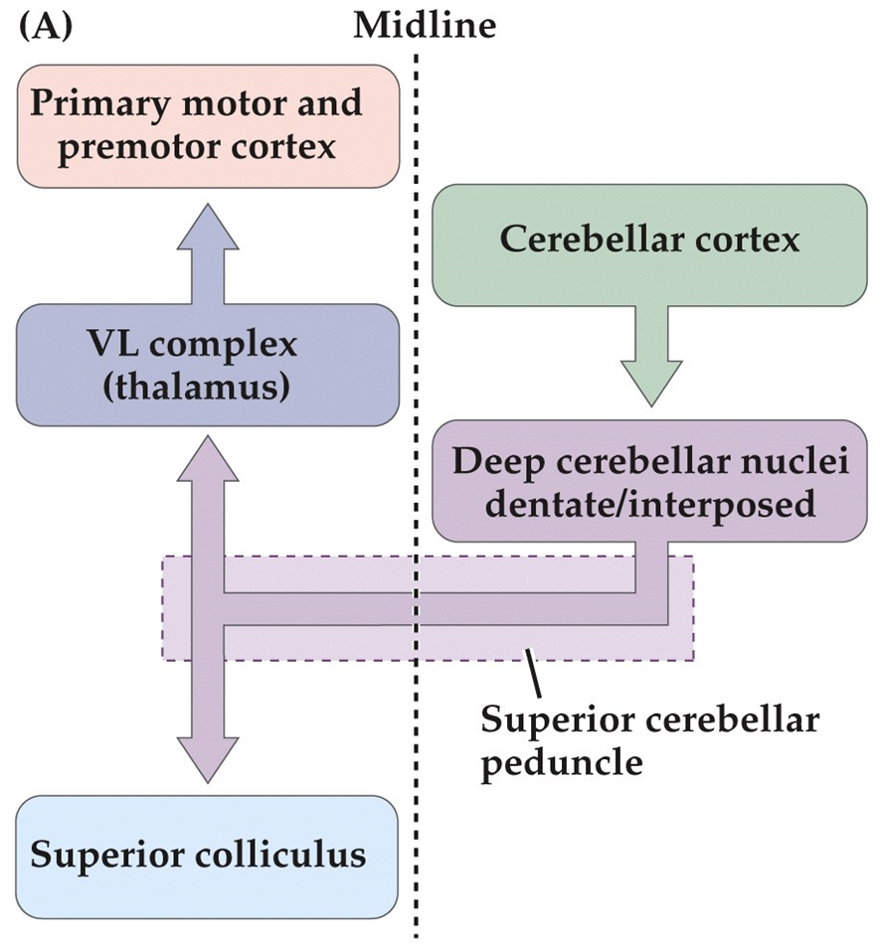
Superior Peduncle Pathways
Pathways from the dentate nucleus primarily travel to premotor and association cortices.
  Input from cerebrocerebellum
  Planning and initiating voluntary movements
Pathways from the interposed nuclei primarily travel to parts of motor cortex associated with limb movement.
  Input from spinocerebellum
Both send projections to the superior colliculus
  Orienting movements of head and eyes

Slide 13
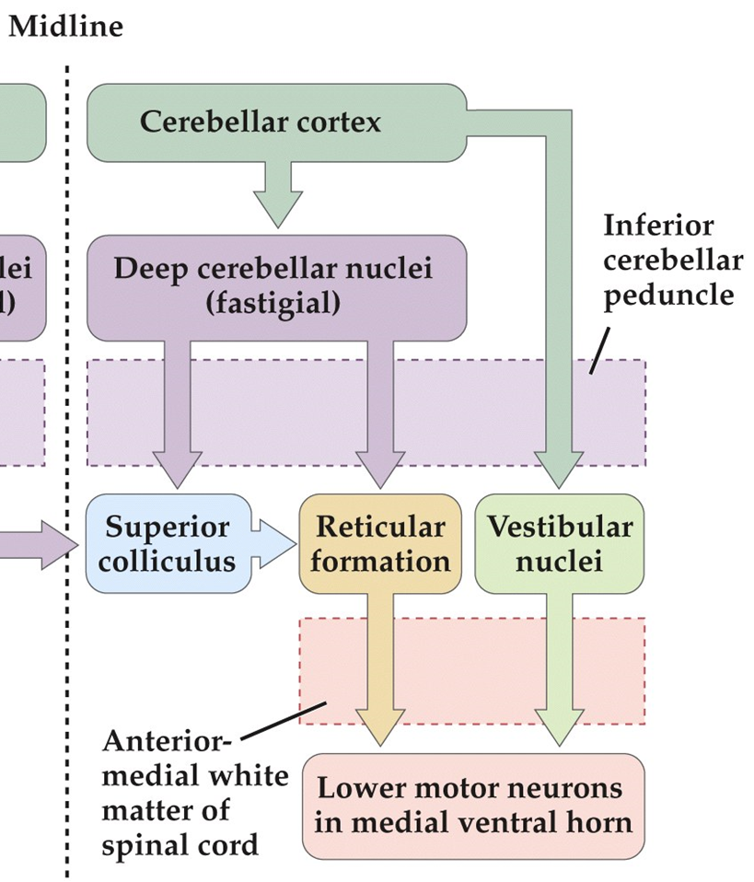
Inferior Peduncle Efferent Pathways
Input primarily from spinocerebellum to the fastigial nuclei.
  There is also some input from the vestibulocerebellum.
  The fastigial nuclei send information to the reticular formation and superior colliculus.
Projections directly from the vestibulocerebellum also form part of the inferior peduncle on their way to the vestibular nuclei in the brainstem

Slide 14
Cerebellum Pathways Summary
Starting Point | Afferent Pathway(s) | Cerebellar Cortex | Cerebellar Deep Nuclei | Efferent Pathway(s) | End Point
Motor Cortex
Spinal Cord
Vestibular nuclei

Slide 15
Cerebellum Pathways Summary
Starting Point | Afferent Pathway(s) | Cerebellar Cortex | Cerebellar Deep Nuclei | Efferent Pathway(s) | End Point
Motor Cortex | Middle and inferior | cerebrocerebellum | Dentate nucleus | superior | Motor cortex and SC
Spinal Cord | inferior | spinocerebellum | Interposed and fastigial nuclei | Superior and inferior | Motor cortex, SC, and reticular formation
Vestibular nuclei | inferior | vestibulocerebellum | Some projections to fastigial nuclei | inferior | Vestibular nuclei

Slide 16
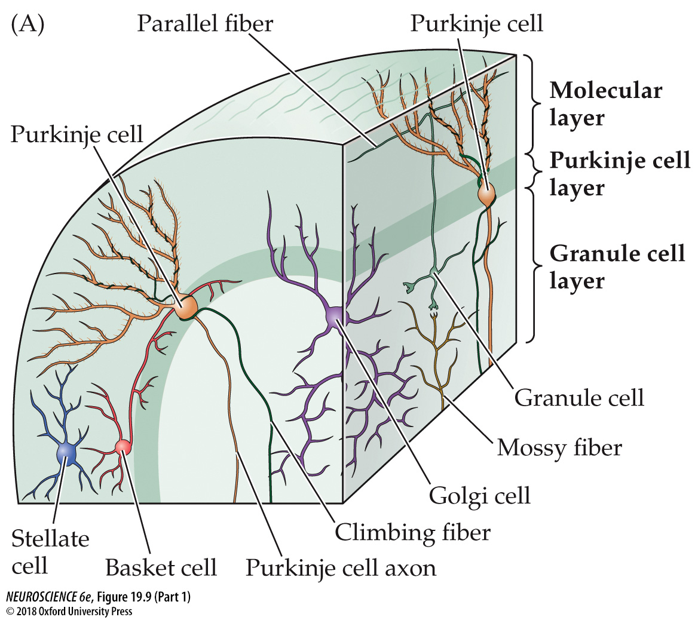
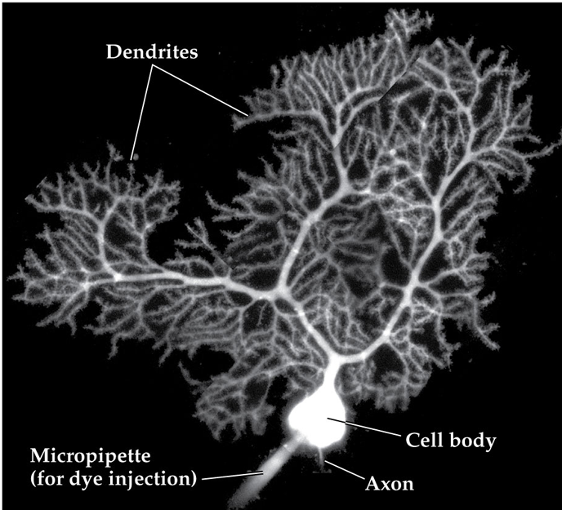
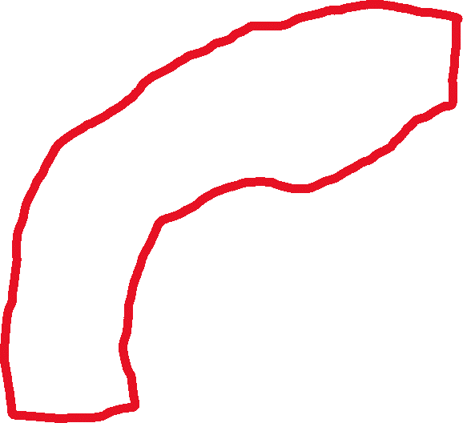
Layers of the Cerebellum
Molecular layer
  Basket & stellate cell bodies
  Purkinje cell dendrites
  Granule cell axons (parallel fibers)
Basket cells and Stellate cells: inhibitory interneurons that inhibit Purkinje cells

Slide 17
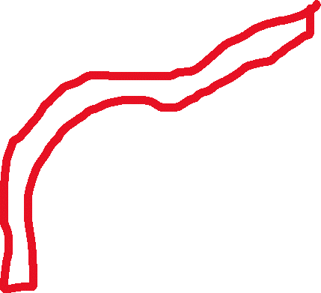
Layers of the Cerebellum
Purkinje cell layer
  Purkinje cell bodies
  Climbing fiber synaptic connections
Purkinje cells: GABAergic neuron inhibiting neurons in the deep cerebellar nuclei
Climbing Fibers: axons from the olivary nucleus of the medulla oblongata that use glutamate to excite Purkinje cells and neurons in the deep nuclei

Slide 18

Layers of the Cerebellum
Granule cell layer
  Granule & Golgi cell bodies
  Climbing fiber and Purkinje cell axons
  Mossy fiber synaptic connections
Granule cells: Glutamatergic cells that excite Purkinje cells via axonal branches called parallel fibers
  Activated by mossy fibers
Mossy Fibers: afferent fibers that activate granule cells (glutamate) & cells of the deep cerebellar nuclei
Golgi cells: inhibitory interneurons that inhibit granule cells

Slide 19
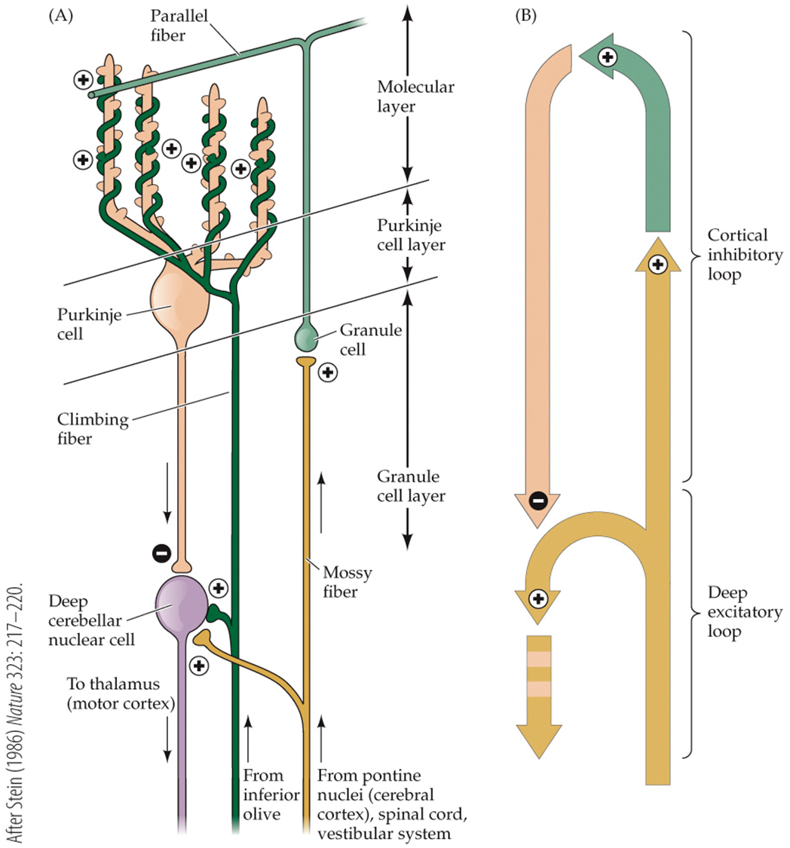
Circuits Within the Cerebellum
Deep excitatory loop
  Cells of the deep nuclei receive excitatory signals from climbing fibers (from inferior olive) and mossy fibers (all other afferents).
Cortical inhibitory loop
  Purkinje cells receive excitatory signals from climbing fibers and parallel fibers.
    Granule cells are activated by mossy fibers
  Purkinje cell receive inhibitory signals from basket and stellate cells.
  Allows for “motor error” to be addressed while movement is ongoing

Slide 20
Summary of Cells and Fibers of the Cerebellum
Cell name | Fiber name (if applicable) | Input from | Output to | Output type (excitatory or inhibitory)
Basket | N/A | N/A
Stellate | N/A
Golgi | N/A
Purkinje | N/A
Granule
 | Mossy
 | Climbing

Slide 21
Cell name | Fiber name (if applicable) | Input from | Output to | Output type (excitatory or inhibitory)
Basket | N/A | N/A | Purkinje cells | inhibitory
Stellate | N/A | Parallel fibers | Purkinje cells | inhibitory
Golgi | N/A | Parallel fibers | Granule cells | inhibitory
Purkinje | N/A | Parallel fibers, Climbing fibers, Stellate and basket cells | Deep nuclei cells | inhibitory
Granule | Parallel | Mossy fibers | Purkinje cells | excitatory
 | Mossy | Most afferents except the inferior olive | Granule cells and deep nuclei | excitatory
 | Climbing | Inferior olive | Purkinje cells and deep nuclei | excitatory

Slide 22
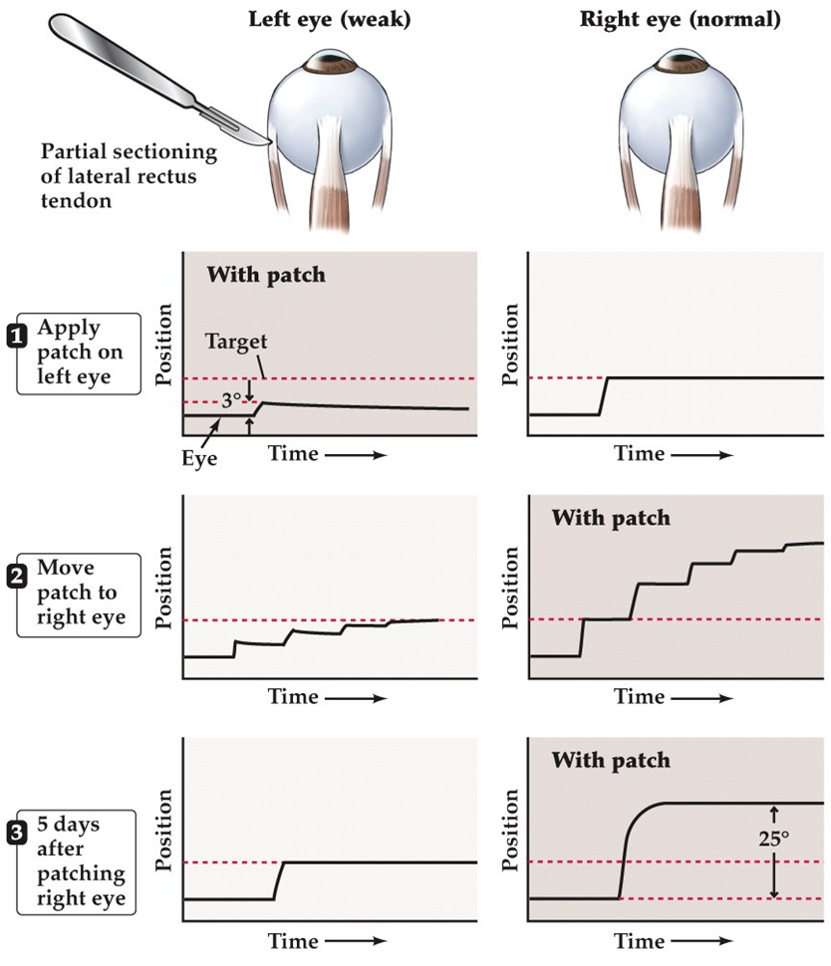
Reducing Motor Error Increases Accuracy and Precision
Motor error: the difference between the precision and accuracy of an intended and an actual movement.
  Reduction of motor error is important for adapting to changing circumstances while a movement is being carried out.
Climbing fibers send information about motor error to Purkinje cells.
Discharge patterns of Purkinje cells modulate output of the deep nuclei.
Cells of the deep nuclei send corrective signals to UMNs

Slide 23
Damage to the Cerebellum
Cerebellar damage causes persistent errors in ongoing movements (incoordination) ipsilateral to the site of damage.
Location specific due to topographical organization
Damage to cerebrocerebellum impairs highly skilled movement and motor learning.
Damage to vestibulocerebellum results in difficulty standing upright and maintaining fixation with the eyes
Cerebellar motor syndrome
  Damage to Spinocerebellum
  Ataxia: inability to coordinate voluntary muscular movements
  Intention tremor: task-related shakiness of the hands
  Dysdiadochokinesia: deficits in rapidly alternating movements
  Dysmetria: over-reaching and under-reaching

Slide 24
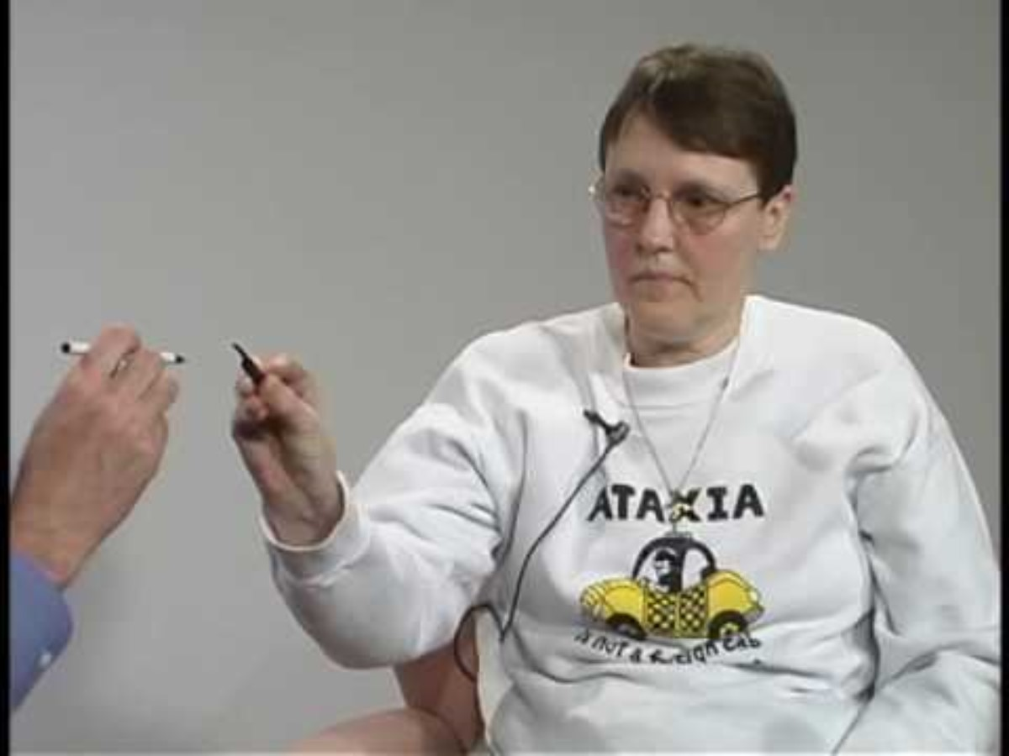
Individual with Cerebellar Motor Syndrome
Notes:
https://www.youtube.com/watch?v=-dFMisBl1aM

Slide 25
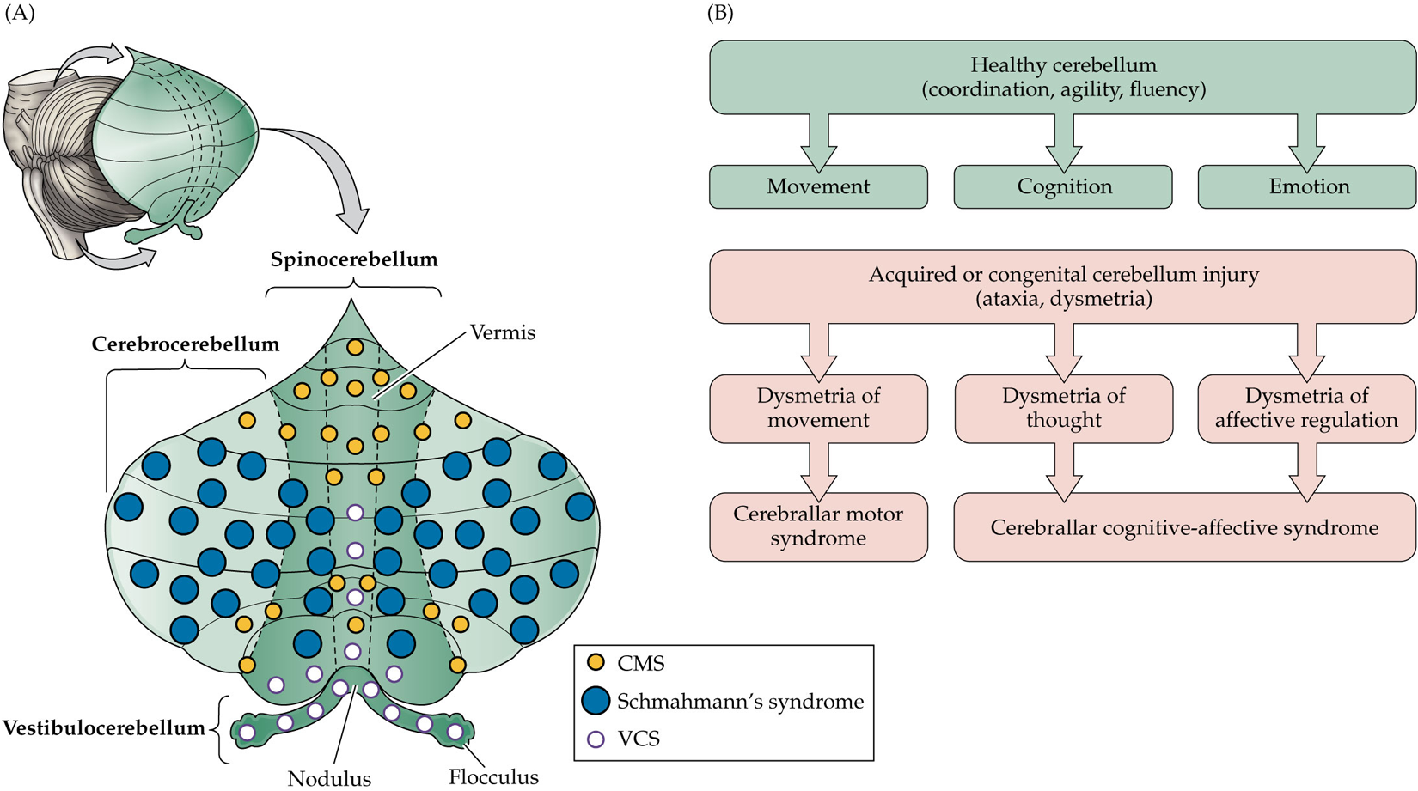
Non-Motor Impairments
Schmahmann’s Syndrome
  Lesions to posterior lateral cerebellar cortex
  Impaired executive functioning, visual spatial processing, linguistic abilities, and emotion regulation.
    Dysmetria of thought and emotion
Abnormal cerebellar development linked to:
  Intellectual disability
  Down syndrome
  ASD
  ADHD

